Slide 1
Example of SeqSpec
triggering errors in the CRISPR-pipeline
*OBS:
The problem captured in this example is an indication that the representation that you defined probably is not corrected, besides being validated by seqspec check).
The solution here works for this case but needs to be validated base by case.
The example demonstrated here comes from : IGVFDS0137RSXB and besides being the illustrative example used, this problem is found in almost all seqspec used to test the CRISPR-pipeline until the moment.

Slide 2
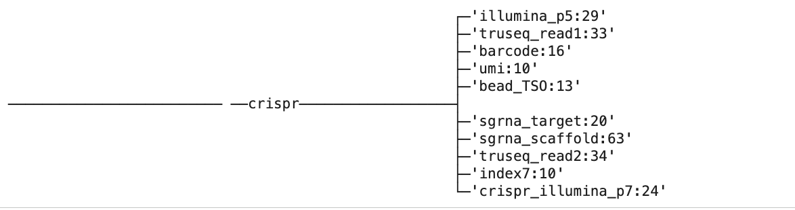
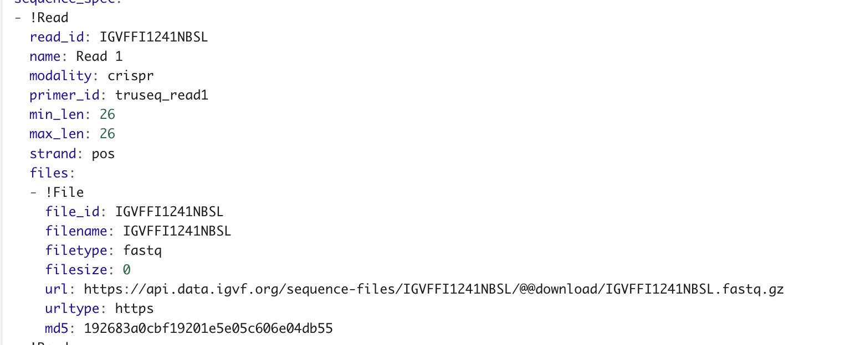
IGVFDS0137RSXB (single cell 10xv2 guide )
Let's start inspect a read and highlighting the desired elements
Main features (Barcode/UMI/feature) that should be encoded inside a seqspec file for a guide file.
Example of a real read pair
Read 1 CB(16) (pos 0-16) UMI(10) (pos 16-26) ACCAGTAGTATCTGCAGAGTAACGGATCTCCTATATATCGCTTTCTTCAGCTCCGAGGGGTTTAAGAGCTAAGCTGGAAACAGCATAGCAAGTTTAAATAAGGCTAGTCCGTTATCAACTTGAGATCGGAAGAGCACACGTCTGAACTCCA
Read 2 Feature (Guide)(20)(pos 63-83)
CCCGCTGATCACAAACTAGCCCTCCCTACACCTGCTACGCTGTTTCCCGCTTAGCTCCTAAACTATCACCTCATCTCCCGAACCCCATATAAGAAATTCACTACCCGGCGATAGAACTGATAAGATCGGAAGAGCGTCGTGTAGGGAAAGA
As a example we will use a very detailed seqspec (Link)
created to specify this experimental set (IGVFDS0137RSXB). The following seqspec also contain other elements originally used to generate the guide reads and not just the cb/umi/feature
Note: This seqspec was already validated by the portal when using the command seqspec check in the seqspec IGVF branch containing the 3.0 seqspec version with a few modifications (see : https://github.com/IGVF-DACC/seqspec)
Using the seqspec print command we can see all the elements of this seqspec
When checking the seqspec file we can see that our Read 1 length is defined as 26bp (read 2 has 88-150bp)

Slide 3
Problem
Inserting other elements in the beginning of the reads, while they are not represented in the observed read causes some representation
errors
What seqspec is really expecting:
Expecting read1 being 26 longer. This is important because it will accommodate only up to 26 longer elements by appending small elements (in our case cb and umi).
26bp
What seqspec sees in this seqspec:
26bp
R1 Len expected
truseq_read1:33
CB:16
umi:10
TS0: 13
OTHER ELEMENTS
1) The first elements (trueseq_read1) don’t even fit the expected 26 bp read len and can’t be accommodate here
2) The disconnection between the lengths of the elements being appended and the read length defined by the user causes a shift of elements to read2 to respect the read length pre-defined by the user. In this case trueseq_read1 is pushed to the end of read2. We can also note that CB and UMI are kept inside read 1, but but also in the read2
OTHER ELEMENTS
umi:10
CB:16
truseq_read1:33
R1: 26bp
R2:150
For more details See index command output in the other page
CB:16
umi:10
Notes:
illumina_p5:29'
├─'truseq_read1:33'
├─'barcode:16'
├─'umi:10'
├─'bead_TSO:13'
───────────────────────── ──crispr──────────────────┤
├─'sgrna_target:20'
├─'sgrna_scaffold:63'
├─'truseq_read2:34'
├─'index7:10'
└─'crispr_illumina_p7:24'

Slide 4
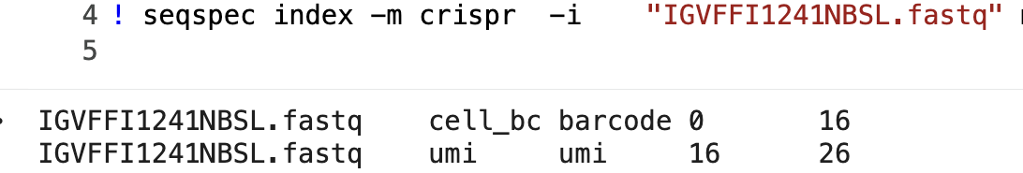
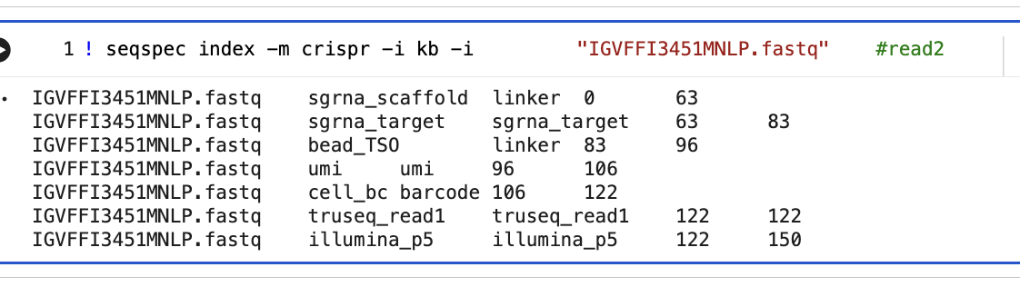
This example gets even clear If we search using seqspec index the elements in the read1. Inspecting it we will noticed that CB and UMI are in the correct position in read1
But we can see that our CB and UMI were in some way also accommodate in the read2 instead only in read1.
Once seqspec index is designed to capture experiments representing single cell experiments:
CB position
UMI position
Feature (rna/guide/hash) position
If the internal representations of a seqspec are not correct it will return a wrong specification

Slide 5
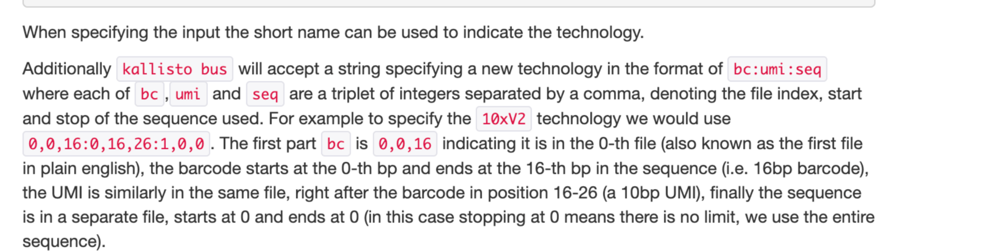
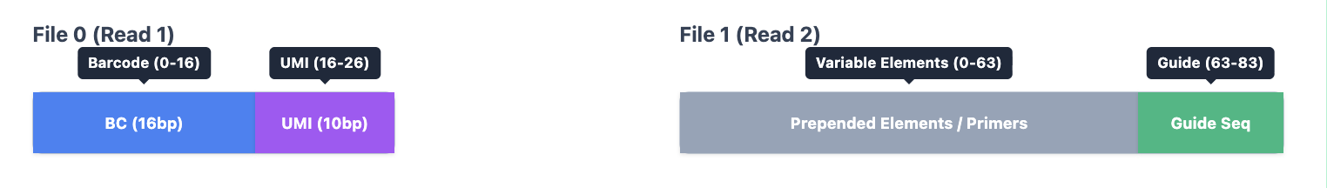
How works the SeqSpec Index representation:
To use kallisto with the seqspec representation
We need to use seqspec index -t kb and the objective is try to generate the following representation (kallisto manual):
In our case the correct one for 10xv2 for this experimental set:
0,0,16 (CB) 1,63,83 (Guide)
0,16,26 (UMI)
Full string generated by index
0,0,16 : 0,16,26 : 1,63,83
0 means read_1
1 means read_2
With this string extract from the seqspec we can redirect the CRISPR-pipeline to the correct read!

Slide 6
But this is the result of the elements structure on this seqspec
The current seqspec demonstrated in this example will generate a confuse string like this:
0,0,16,1,106,122:0,16,26,1,96,106:1,63,83
The scheme show that we have a cell barcode in two positions (0,0,16(read1) and 1,106,122(read2)) and kallisto will consider it as a 32bp barcode instead just 16
Same problem to the UMIs that can be found in two positions and will be considered a 20bp UMI
read1(0,16,26) and read2 (1,96,106)
Feature seems correct

Slide 7
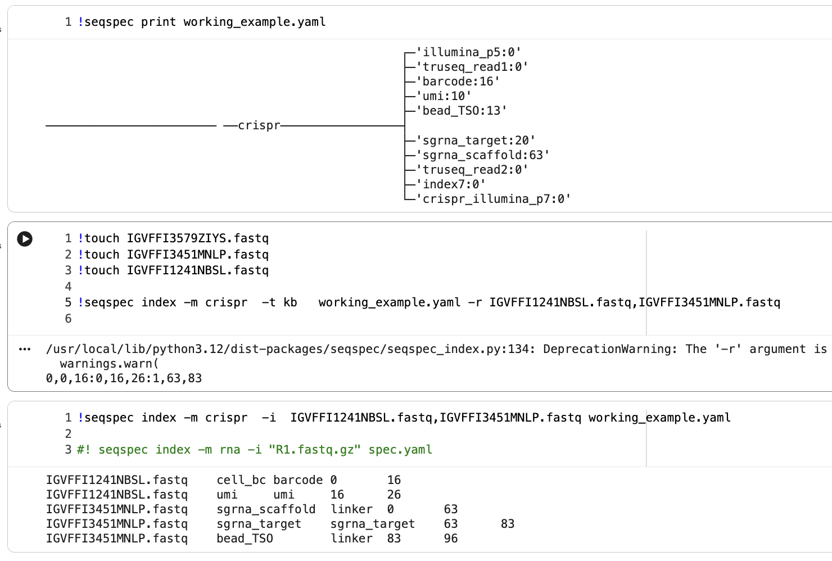
Solutions for this specific seqspec
Working example
Seqspec index -t kb now returns:
0,0,16(cb):0,16,26(umi):1,63,83 (feature)
Or
1,0,16:1,16,26:0,63,83
Or
Read 1 cb position (0,16)
Read 1 umi position (16,26)
Read 2 feature position (63,83)

Slide 8
Solution steps
Make sure the elements are fitting the reads lengths proposed in your seqspec definition.
Remove the length of your primers in your seqspec file (Since they are not represented in your final read)
Always use seqspec index -t and check if your cb:umi:feature are being found in the correct reads
Note: Besides not fixing this seqspec by matching the user defined read length (26) and the observed fastq read length (150). I would recommend it as a good practice, to avoid elements not well characterized in the seqspec that are present in the fastq files)(ex: read 1 is not 26bp it is actually 150 and has a region of 122 bp not well defined in the seqspec(after the UMI).

